Slide 1
Authorization Management in clouds
Authorization refers to specifying the access rights to the protected res0urces using access policies.
OAuth:
Open standard for authorization that allows resource owners to share their private resources stored on one site with another site
OAuth 1.0 protocol was published in 2010 and OAuth 2.0 framework was published in 2012
In OAuth model, an application requests access to resources controlled by the resource owner
The resource owner grants permission to access the resources in the form of a token and matching shared-secret
Token does not share credentials for resources. Tokens can be granted with a restricted scope and limited lifetime

Slide 2
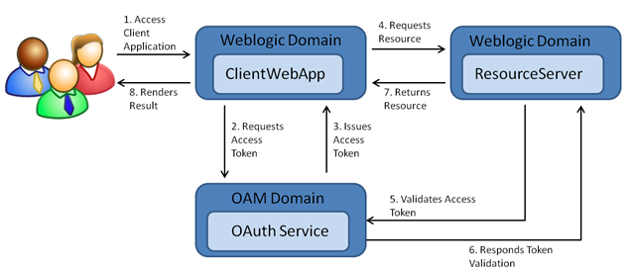
Figure. OAuth Authorization flow

Slide 3
Accounting for Clouds Resource Utilization
Accounting for cloud is the amount of all resources utilized by a user or an organization within a specific time period
Accounting does not allow or deny anything
The utilization should include:
Amount of time the user is logged in and actively using the applications
Hardware resources used such as processing power, memory, and storage space
Amount of data transferred, which can be data that is moved into the cloud, out of the cloud, or between two storage devices within the cloud
The billing rates could be different, based on the origin and destination of the data transfer

Slide 4
Cloud service providers must have a way consumers can review their daily or weekly utilization or in real-time to forecast the bill
There must be a way for a trusted third party to evaluate and verify the resource utilization and billing
The administrator must be able to set quotas (maximum allowed utilization) for each user, application, or resource
Payment per billing period must be based on the following:
Reserved Resources—The user or customer may reserve storage space, CPU, and memory for its use
Utilized Resources—The billing for bandwidth and application time would be based on actual utilization by the customer

Slide 5
Accounting keeps a log of resource consumption such as the following:
Identity of the user
Amount of resource used
Start and end time of use Chapter
Amount of data transferred
Length of connection
Purpose of using the resource
Nature of service delivered
Following are the two types of accounting reports:
Real Time Accounting Information: Useful for cloud users to track usage and predict the bill, expected at the end of the payment cycle
Batch Accounting Information: Useful for cloud service providers for billing at the end of each payment cycle. The data is also used for studying utilization trends and capacity planning

Slide 6
Module 4
Cloud Deployment Techniques

Slide 7
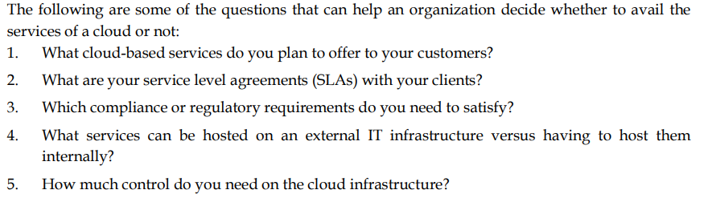

Slide 8
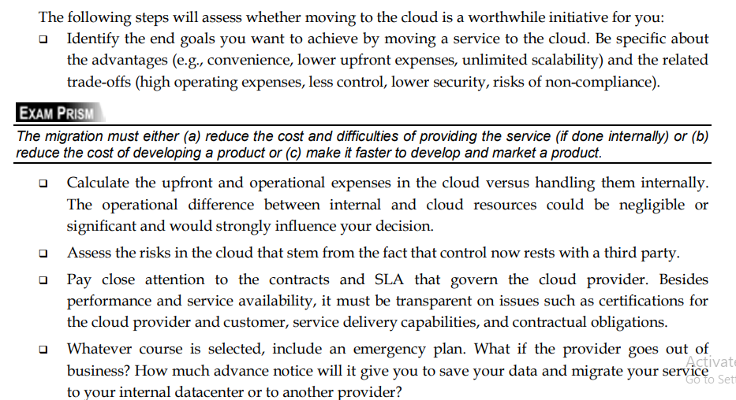

Slide 9
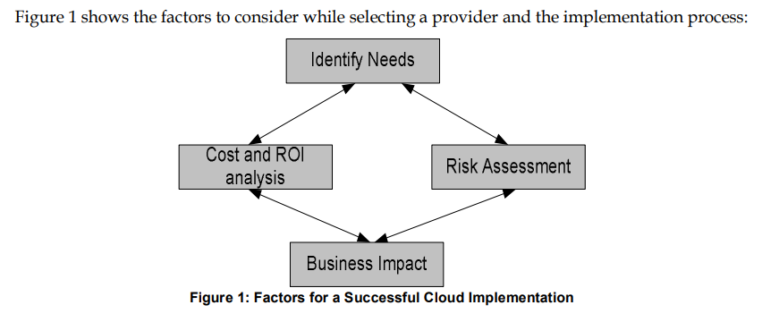

Slide 10
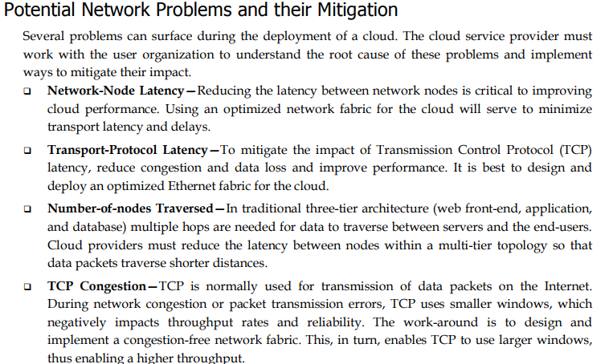

Slide 11
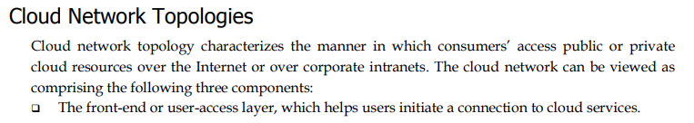
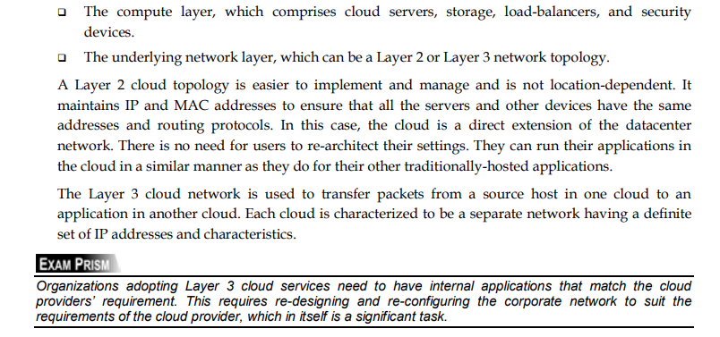

Slide 12
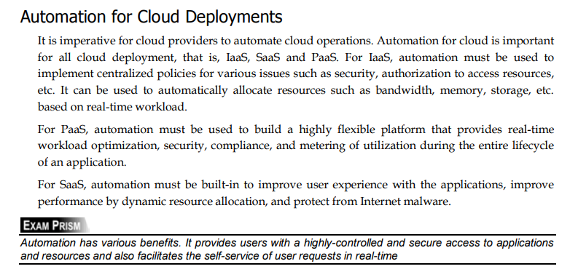

Slide 13
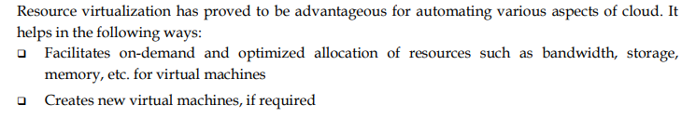
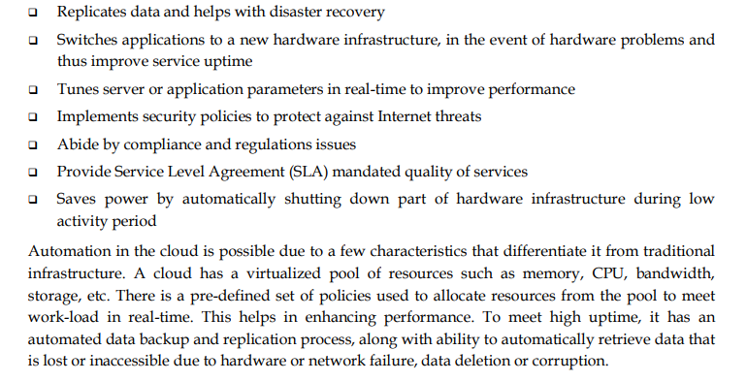

Slide 14
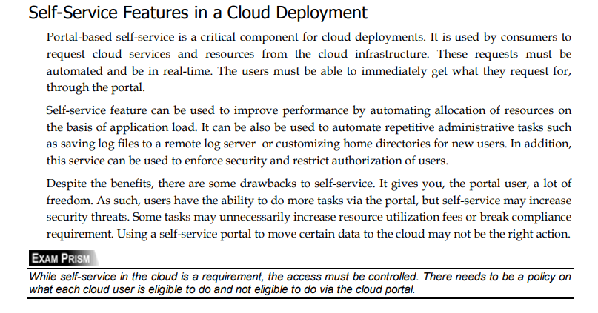

Slide 15
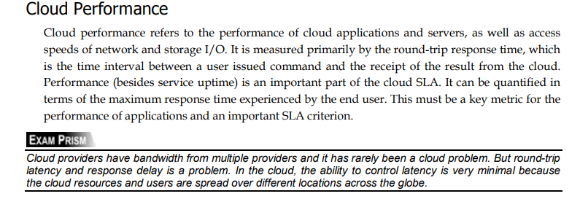
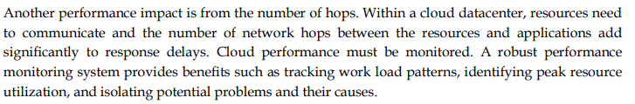

Slide 16
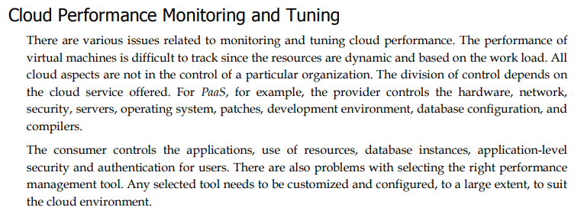

Slide 17
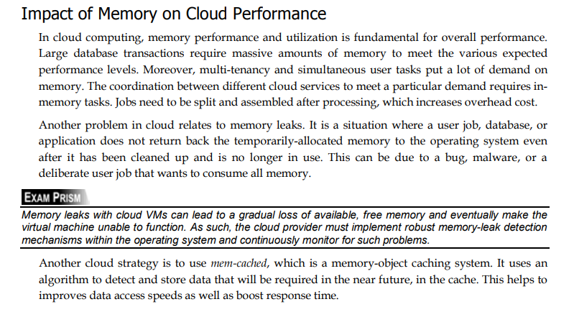

Slide 18
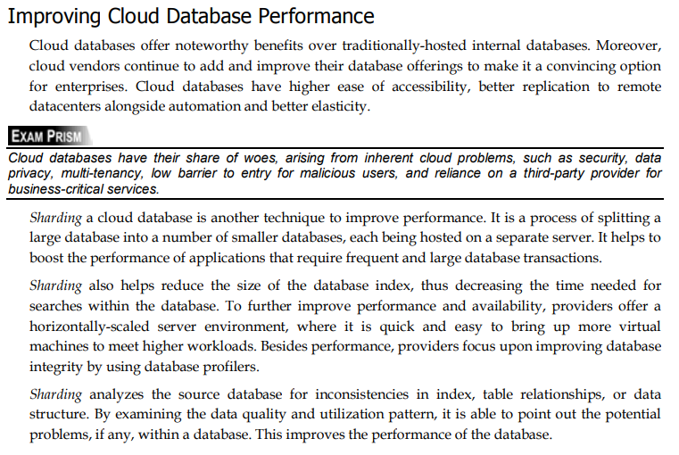

Slide 19
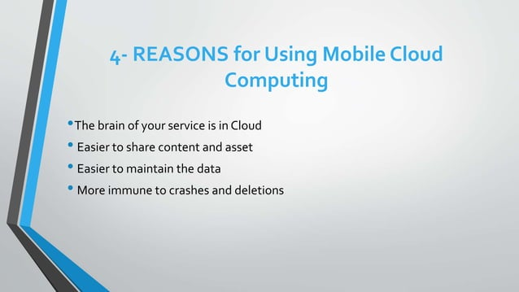

Slide 20
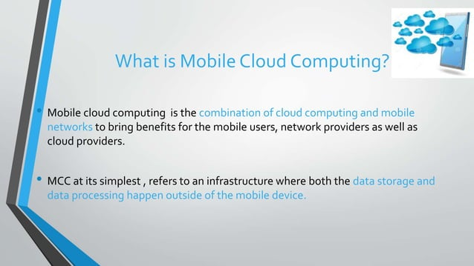

Slide 21
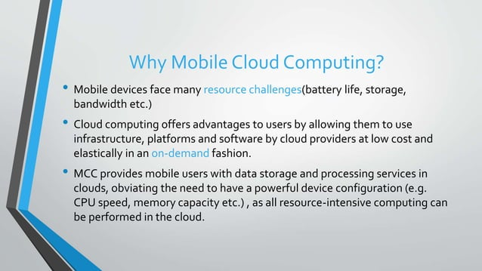

Slide 22
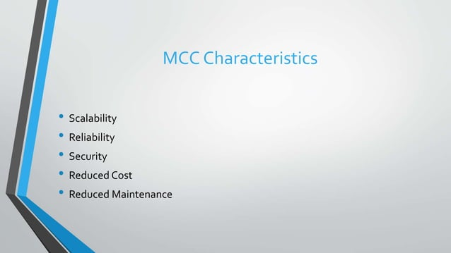

Slide 23
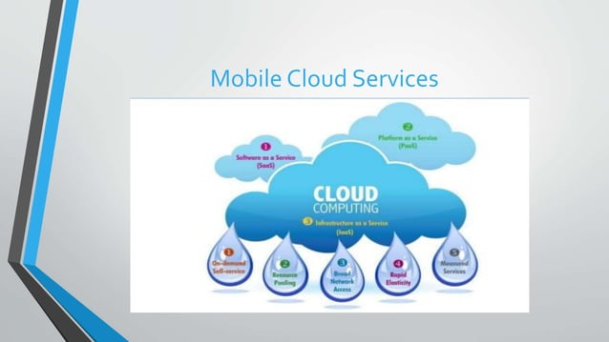

Slide 24
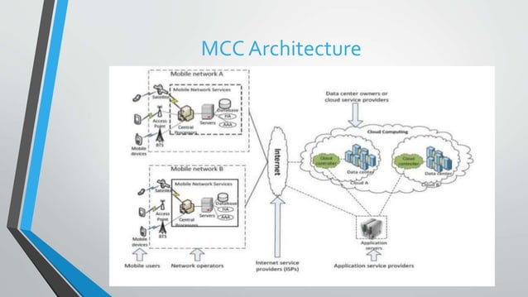
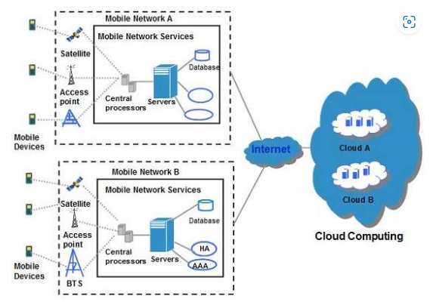

Slide 25
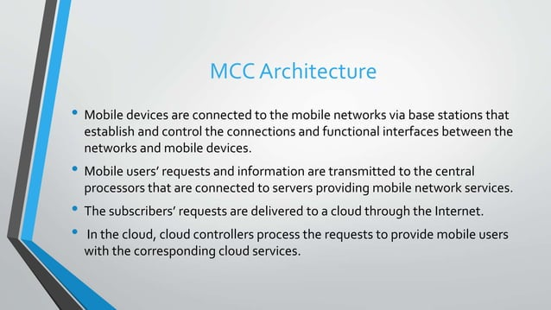

Slide 26
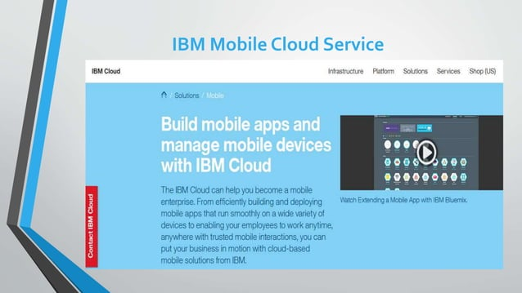

Slide 27
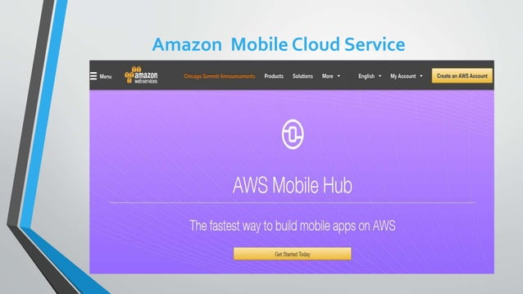

Slide 28
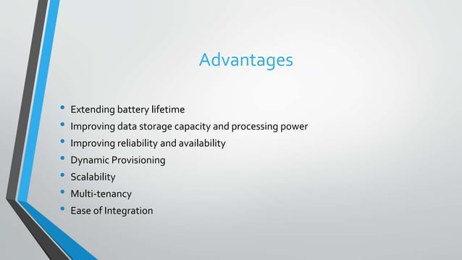

Slide 29
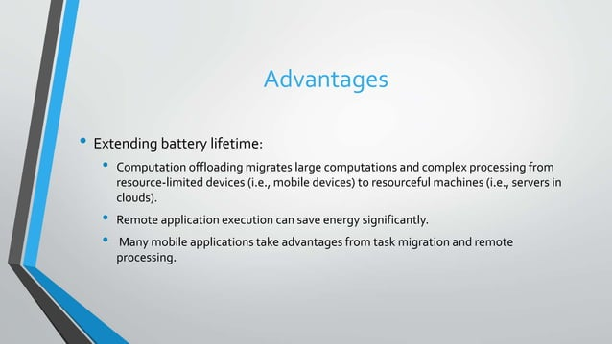

Slide 30
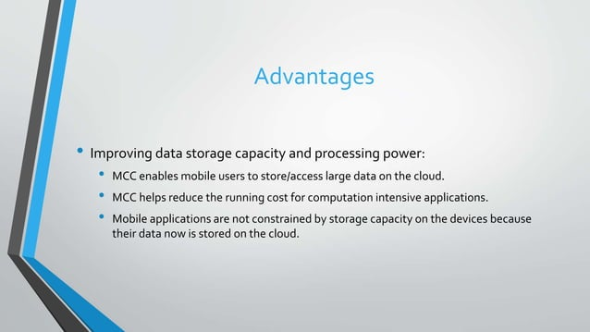

Slide 31
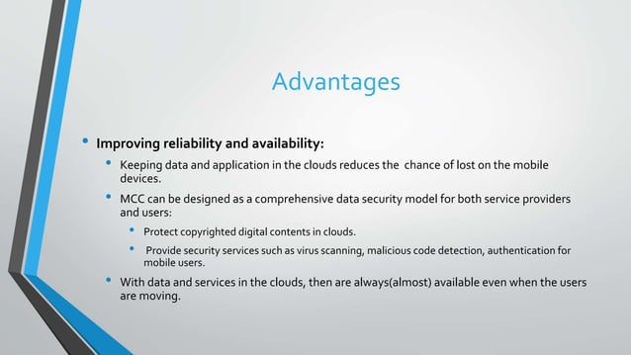

Slide 32
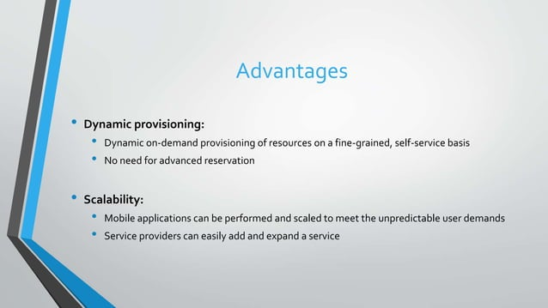

Slide 33
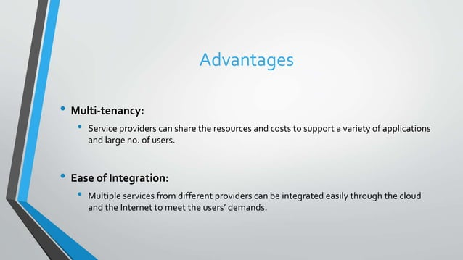

Slide 34
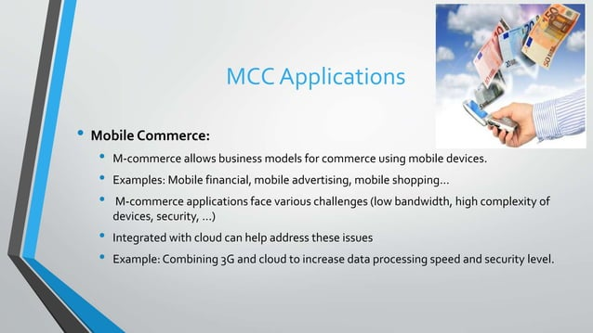

Slide 35
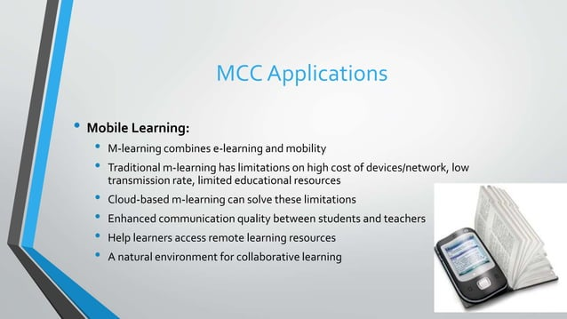

Slide 36
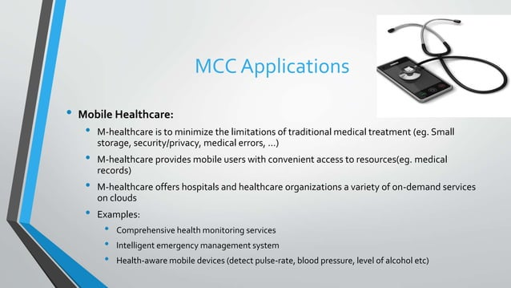

Slide 37
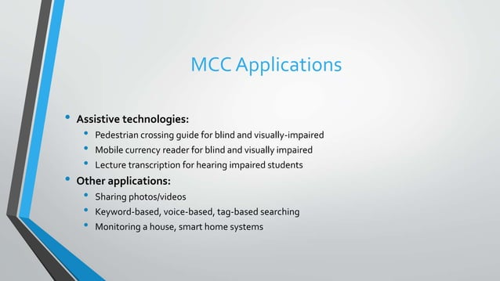

Slide 38
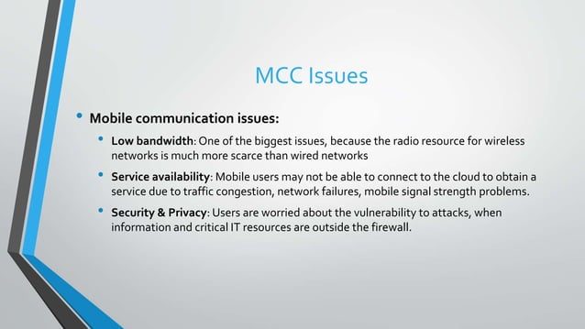

Slide 39
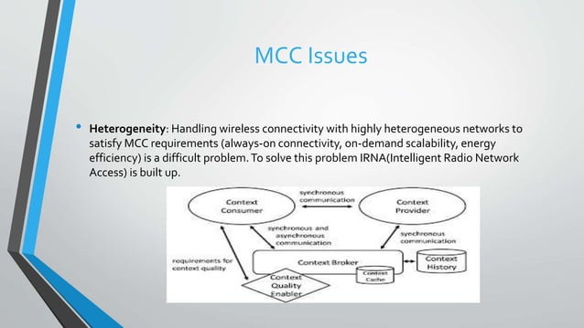

Slide 40
